Slide 1
Instructions for Presentation on TES Screening Procedures
Please use this slide deck from a TES training in Angola as a template for presenting TES screening procedures to your in-country TES team.
There are additional instructions in the notes for each slide.

Slide 2
Procedures
Screening - Day 0

Slide 3
Purpose of Screening
1
Identify:
"Which patients can be part of the study?"
Check:
"Of these patients, which meet all the inclusion criteria and none of the exclusion criteria?"
Invite:
"Of these patients, which ones would you agree to be part of the study?"
2
3

Slide 4
Purpose of Screening
1
Identify:
"Which patients can be part of the study?"
Check:
"Of these patients, which ones meet all the inclusion criteria and none of the exclusion criteria?"
Invite:
"Of these patients, which ones would you agree to be part of the study?"
2
3

Slide 5
Purpose of Screening
1
Identify:
"Which patients can be part of the study?"
Check:
"Of these patients, which ones meet all the inclusion criteria and none of the exclusion criteria?"
Invite:
"Of these patients, which ones would you agree to be part of the study?"
2
3

Slide 6
Inclusion Criteria
Age
Temperature
Weight
Parasite density
Haemoglobin
Access
Consent

Slide 7
Inclusion - Age
6 - 59 months (<5 years) in Zaire and Lunda Sul
6 - 143 months (<12 years) in Benguela
ATTENTION: Age on Day 0 of the study!!!!
Notes:
Modify this slide so that it represents the age inclusion criteria for your country’s study

Slide 8
Inclusion - Age
6 - 59 months (<5 years) in Zaire and Lunda Sul
6 - 143 months (<12 years) in Benguela
Can this child participate? Yes or no?
6 months?

Slide 9
Inclusion - Age
6 - 59 months (<5 years) in Zaire and Lunda Sul
6 - 143 months (<12 years) in Benguela
Can this child participate? Yes or no?
6 months? YES

Slide 10
Inclusion - Age
6 - 59 months (<5 years) in Zaire and Lunda Sul
6 - 143 months (<12 years) in Benguela
Can this child participate? Yes or no?
6 months? YES
59 months?

Slide 11
Inclusion - Age
6 - 59 months (<5 years) in Zaire and Lunda Sul
6 - 143 months (<12 years) in Benguela
Can this child participate? Yes or no?
6 months? YES
59 months? YES

Slide 12
Inclusion - Age
6 - 59 months (<5 years) in Zaire and Lunda Sul
6 - 143 months (<12 years) in Benguela
Can this child participate? Yes or no?
6 months? YES
59 months? YES
143 months?

Slide 13
Inclusion - Age
6 - 59 months (<5 years) in Zaire and Lunda Sul
6 - 143 months (<12 years) in Benguela
Can this child participate? Yes or no?
6 months? YES
59 months? YES
143 months? ONLY IN BENGUELA

Slide 14
Inclusion - Age
6 - 59 months (<5 years) in Zaire and Lunda Sul
6 - 143 months (<12 years) in Benguela
Can this child participate? Yes or no?
6 months? YES
59 months? YES
143 months? ONLY IN BENGUELA
5 years?

Slide 15
Inclusion - Age
6 - 59 months (<5 years) in Zaire and Lunda Sul
6 - 143 months (<12 years) in Benguela
Can this child participate? Yes or no?
6 months? YES
59 months? YES
143 months? ONLY IN BENGUELA
5 years? ONLY IN BENGUELA

Slide 16
Inclusion - Age
6 - 59 months (<5 years) in Zaire and Lunda Sul
6 - 143 months (<12 years) in Benguela
Can this child participate? Yes or no?
6 months? YES
59 months? YES
143 months? ONLY IN BENGUELA
5 years? ONLY IN BENGUELA
12 years old?

Slide 17
Inclusion - Age
6 - 59 months (<5 years) in Zaire and Lunda Sul
6 - 143 months (<12 years) in Benguela
Can this child participate? Yes or no?
6 months? YES
59 months? YES
143 months? ONLY IN BENGUELA
5 years? ONLY IN BENGUELA
12 years old? NO

Slide 18
Inclusion - Weight
At least 5 Kg

Slide 19
Inclusion - Weight
At least 5 Kg
What if the child has too many clothes?

Slide 20
Inclusion - Weight
At least 5 Kg
What if the child has too many clothes?
Remove heavy clothes!

Slide 21
Inclusion - Weight
At least 5 Kg
What if the child has too many clothes?
Remove heavy clothes!
Can this child participate? Yes or no?
5 Kg?

Slide 22
Inclusion - Weight
At least 5 Kg
What if the child has too many clothes?
Remove the heavy clothes!
Can this child participate? Yes or no?
5 Kg? YES

Slide 23
Inclusion - Weight
At least 5 Kg
What if the child has too many clothes?
Remove the heavy clothes!
Can this child participate? Yes or no?
5 Kg? YES
5.1 Kg with a lot of clothes?

Slide 24
Inclusion - Weight
At least 5 Kg
What if the child has too many clothes?
Remove the heavy clothes!
Can this child participate? Yes or no?
5 Kg? YES
5.1 Kg with a lot of clothes? NO

Slide 25
Inclusion - Weight
At least 5 Kg
What if the child has too many clothes?
Remove the heavy clothes!
Can this child participate? Yes or no?
5 Kg? YES
5.1 Kg with a lot of clothes? NO
498 grams?

Slide 26
Inclusion - Weight
At least 5 Kg
What if has too many clothes?
Remove the heavy clothes!
Can this child participate? Yes or no?
5 Kg? YES
5.1 Kg with a lot of clothes? NO
498 grams? NO

Slide 27
Inclusion - Infection
Mono-infection with P. falciparum
Parasite density:
Lunda Sul and Zaire: 2,000 - 200,000 asexual parasites per microlitre of blood
Benguela: 1,000 - 100,000 asexual parasites per microlitre of blood
Notes:
Modify this slide to represent the parasite density range for your country’s study

Slide 28
Inclusion - Infection
Mono-infection with P. falciparum
Parasite density:
Lunda Sul and Zaire: 2,000 - 200,000 asexual parasites per microlitre of blood
Benguela: 1,000 - 100,000 asexual parasites per microlitre of blood
Can this child participate? Yes or no?
Parasite density of 1,000?
Notes:
Modify this slide to represent the parasite density range for your country’s study

Slide 29
Inclusion - Infection
Mono-infection with P. falciparum
Parasite density:
Lunda Sul and Zaire: 2,000 - 200,000 asexual parasites per microlitre of blood
Benguela: 1,000 - 100,000 asexual parasites per microlitre of blood
Can this child participate? Yes or no?
Parasite density of 1,000? Only in Benguela
Notes:
Modify this slide to represent the parasite density range for your country’s study

Slide 30
Inclusion - Infection
Mono-infection with P. falciparum
Parasite density:
Lunda Sul and Zaire: 2,000 - 200,000 asexual parasites per microlitre of blood
Benguela: 1,000 - 100,000 asexual parasites per microlitre of blood
Can this child participate? Yes or no?
Parasite density of 1,000? Only in Benguela
P. vivax infection?
Notes:
Modify this slide to represent the parasite density range for your country’s study

Slide 31
Inclusion - Infection
Mono-infection with P. falciparum
Parasite density:
Lunda Sul and Zaire: 2,000 - 200,000 asexual parasites per microlitre of blood
Benguela: 1,000 - 100,000 asexual parasites per microlitre of blood
Can this child participate? Yes or no?
Parasite density of 1,000? Only in Benguela
P. vivax infection? NO

Slide 32
Inclusion - Infection
Mono-infection with P. falciparum
Parasite density:
Lunda Sul and Zaire: 2,000 - 200,000 asexual parasites per microlitre of blood
Benguela: 1,000 - 100,000 asexual parasites per microlitre of blood
Can this child participate? Yes or no?
Parasite density of 1,000? Only in Benguela
P. vivax infection? NO
Parasite density of 110,000?

Slide 33
Inclusion - Infection
Mono-infection with P. falciparum
Parasite density:
Lunda Sul and Zaire: 2,000 - 200,000 asexual parasites per microlitre of blood
Benguela: 1,000 - 100,000 asexual parasites per microlitre of blood
Can this child participate? Yes or no?
Parasite density of 1,000? Only in Benguela
P. vivax infection? NO
Parasite density of 110,000? Only in Lunda Sul or Zaire

Slide 34
Inclusion - Infection
Mono-infection with P. falciparum
Parasite density:
Lunda Sul and Zaire: 2,000 - 200,000 asexual parasites per microlitre of blood
Benguela: 1,000 - 100,000 asexual parasites per microlitre of blood
Can this child participate? Yes or no?
Parasite density of 1,000? Only in Benguela
P. vivax infection? NO
Parasite density of 110,000? Only in Lunda Sul or Zaire
Parasite density of 50,000?

Slide 35
Inclusion - Infection
Mono-infection with P. falciparum
Parasite density:
Lunda Sul and Zaire: 2,000 - 200,000 asexual parasites per microlitre of blood
Benguela: 1,000 - 100,000 asexual parasites per microlitre of blood
Can this child participate? Yes or no?
Parasite density of 1,000? Only in Benguela
P. vivax infection? NO
Parasite density of 110,000? Only in Lunda Sul or Zaire
Parasite density of 50,000? YES

Slide 36
Inclusion - Temperature
Axillary temperature of at least 37.5°C during the visit to the health facility
OR
Had a fever in the last 24 hours

Slide 37
Inclusion - Temperature
Axillary temperature greater than or equal to (≥) 37.5°C during the visit to the health facility
OR
Had a fever in the last 24 hours
Can this child participate? Yes or no?
37.5ºC?

Slide 38
Inclusion - Temperature
Axillary temperature of at least 37.5°C during the visit to the health facility
OR
Had a fever in the last 24 hours
Can this child participate? Yes or no?
37.5ºC? YES

Slide 39
Inclusion - Temperature
Axillary temperature of at least 37.5°C during the visit to the health facility
OR
Had a fever in the last 24 hours
Can this child participate? Yes or no?
37.5ºC? YES
37.4ºC did you have a fever last night?

Slide 40
Inclusion - Temperature
Axillary temperature of at least 37.5°C during the visit to the health facility
OR
Had a fever in the last 24 hours
Can this child participate? Yes or no?
37.5ºC? YES
37.0ºC did you have a fever last night? YES

Slide 41
Inclusion - Temperature
Axillary temperature of at least 37.5°C during the visit to the health facility
OR
Had a fever in the last 24 hours
Can this child participate? Yes or no?
37.5ºC? YES
37,0ºC last night? YES
37.0ºC had a fever 2 days ago?

Slide 42
Inclusion - Temperature
Axillary temperature of at least 37.5°C during the visit to the health facility
OR
Had a fever in the last 24 hours
Can this child participate? Yes or no?
37.5ºC? YES
37,0ºC last night? YES
37.0ºC had a fever 2 days ago? NO

Slide 43
Inclusion - Haemoglobin
Haemoglobin greater than (>) 8.0 g/dl
Measuring with HemoCue

Slide 44
Inclusion - Haemoglobin
Haemoglobin greater than (>) 8.0 g/dl
Measuring with HemoCue
Can this child participate? Yes or no?
8.5 g/dl?

Slide 45
Inclusion - Haemoglobin
Haemoglobin greater than (>) 8.0 g/dl
Measuring with HemoCue
Can this child participate? Yes or no?
8.5 g/dl? YES

Slide 46
Inclusion - Haemoglobin
Haemoglobin greater than (>) 8.0 g/dl
Measuring with HemoCue
Can this child participate? Yes or no?
8.5 g/dl? YES
7.9 g/dl?

Slide 47
Inclusion - Haemoglobin
Haemoglobin greater than (>) 8.0 g/dl
Measuring with HemoCue
Can this child participate? Yes or no?
8.5 g/dl? YES
7.9 g/dl? NO

Slide 48
Inclusion - Haemoglobin
Haemoglobin greater than (>) 8.0 g/dl
Measuring with HemoCue
Can this child participate? Yes or no?
8.5 g/dl? YES
7.9 g/dl? NO
8.0 g/dl?

Slide 49
Inclusion - Haemoglobin
Haemoglobin greater than (>) 8.0 g/dl
Measuring with HemoCue
Can this child participate? Yes or no?
8.5 g/dl? YES
7.9 g/dl? NO
8.0 g/dl? NO

Slide 50
Inclusion - Access to the health facility
Easy access to the health facility
The possibility of being present at the health unit on evaluation days during the 28 or 42 day follow up period

Slide 51
Inclusion - Access to the health facility
Easy access to the health facility
The possibility of being present at the health unit on evaluation days during the 28 or 42 day period
Can this child participate? Yes or no?
It takes more than 3 hours to reach the child's home and there is no regular transport?

Slide 52
Inclusion - Access to the health facility
Easy access to the health facility
The possibility of being present at the health unit on evaluation days during the 28 or 42 day period
Can this child participate? Yes or no?
It takes more than 3 hours to get to the child's home and there is no regular transport? NO

Slide 53
Inclusion - Consent
Consent of parents or caregivers, after explanation of the purpose of the assessment
Participation is voluntary

Slide 54
Inclusion - Consent
Consent of parents or caregivers, after explanation of the purpose of the assessment
Participation is voluntary
Can this child participate? Yes or no?
The mother says yes and the father is not present?
The mother says no but the father says yes?
The child is only accompanied by her sister who is 15 years old and the sister says yes?

Slide 55
Inclusion - Consent
Consent of parents or caregivers, after explanation of the purpose of the assessment
Participation is voluntary
Can this child participate? Yes or no?
Does the mother say yes and the father is not present? YES
Does the mother say no but the father says yes? NO
The child is only accompanied by her sister who is 15 years old and the sister says yes? NO

Slide 56
Summary: Inclusion Criteria
Age:
Between ___ and ___ months in Benguela
Between ___ and ___ months in Lunda Sul and Zaire
Weight greater than or equal to ___ Kg
Mono-infection with P. falciparum with a parasite density:
Between _______ and _______ parasites/microlitre of blood in Benguela
Between _______ and _______ parasites/microlitre of blood in Lunda Sul and Zaire
Axillary temperature ____ ºC during the visit to the health facility or fevre in the last ___ hours
Haemoglobin greater than ___ g/dl
How long is the DP follow-up? ___ days
How long is the AL follow-up? ___ days
How long is the ASAQ follow-up? ___ days
Notes:
Delete the drugs in questions 6-8 that are not being assessed in this current study

Slide 57
Summary
Age:
Between 6 and 143 months in Benguela
Between 6 and 59 months in Lunda Sul and Zaire
Weight greater than or equal to 5 Kg
Mono-infection with P. falciparum with a parasite density:
Between 1,000 and 100,000 parasites/microlitre of blood in Benguela
Between 2,000 and 200,000 parasites/microlitre of blood in Lunda Sul and Zaire
Axillary temperature 37.5°C during the visit to the health facility or fevre in the last 24 hours
Haemoglobin greater than 8.0 g/dl
How long is the PD follow-up? 42 days
How long is the AL follow-up? 28 days
How long is the ASAQ follow-up? 28 days
Notes:
1-5: Modify to reflect the inclusion criteria of your country’s TES
Delete the drugs in questions 6-8 that are not being assessed in your current study

Slide 58
Exclusion Criteria
Danger signs
Pneumonia or bronchopneumonia
Severe malnutrition
Has taken antimalarial or antibiotic medication
History of allergy or hypersensitivity
Mixed parasitaemia (e.g. infection with Plasmodium falciparum and other parasite)
Notes:
Cross check with your study’s protocol exclusion criteria

Slide 59
Exclusion - Danger Signs
Presence of any danger sign or severe or complicated malaria

Slide 60
Danger Signs
Not being able to breastfeed or drink
Persistent vomiting (> 2 times in 24h)
Recent history of convulsions (>1 in 24h)
Lethargy or unconsciousness
Not being able to sit or stand

Slide 61
Complicated or severe malaria
Clinical Manifestations
Changes in consciousness
Prostration (extreme weakness)
Multiple convulsions
Respiratory distress
Circulatory collapse / shock
Pulmonary edema
Abnormal bleeding
Yellow colour (jaundice)
Presence of blood in the urine (hemoglobinuria)

Slide 62
Complicated or severe malaria
Clinical Signs
Changes in consciousness
Prostration (extreme weakness)
Multiple convulsions
Respiratory distress
Circulatory collapse / shock
Pulmonary edema
Abnormal bleeding
Yellow colour (jaundice)
Presence of blood in the urine (hemoglobinuria)

Slide 63
Complicated or severe malaria
Laboratory Signs
hyperparasitaemia (>4%)
renal insufficiency (elevated serum creatinine)
severe anaemia (haemoglobin < 5 g/dl)
hypoglycaemia (glucose < 40 mg/dl or < 2.2 mmol/dl)
acidosis (bicarbonate < 15 mmol/l)
hyperlactatemia (lactic acid > 5 mmol/l)

Slide 64
Complicated or severe malaria
Laboratory Signs
hyperparasitaemia (>4%)
renal insufficiency (elevated serum creatinine)
severe anaemia (haemoglobin < 5 g/dl)
hypoglycaemia (glucose < 40 mg/dl or < 2.2 mmol/dl)
acidosis (bicarbonate < 15 mmol/l)
hyperlactatemia (lactic acid > 5 mmol/l)

Slide 65
Exclusion - Presence of pneumonia or bronchopneumonia
A child with an acute respiratory condition compatible with pneumonia cannot enter the study
Elevated respiratory rate
Coughing

Slide 66
Exclusion - Presence of pneumonia or bronchopneumonia
Defined as respiratory rate:
> 50 in children under 12 months
>40 in children aged 12-59 months,
>20 in children aged 60-108 months

Slide 67
Exclusion - Severe malnutrition
Standard deviation < -3
Standard deviation is the ratio between the child's weight and the expected weight for age

Slide 68
Exclusion - Other antimalarials
The child must not have taken a medicine with antimalarial effect in the last 14 days
Antimalarials: Coartem, SP, Fansidar, quinine, etc.
Antibiotics such as: cotrimoxazole, tetracycline, doxycycline, clindamycin

Slide 69
Exclusion – Allergy or Hypersensitivity
Signs of hypersensitivity or allergy
Itching
Blisters
Rash or redness
Difficulty in breathing
Swelling

Slide 70
Exclusion - Mixed infection
P. falciparum and the presence of another Plasmodium species:
vivax
ovale
malariae
knowlesi

Slide 71
Procedures - TREATMENT
The nurse identifies children between the required ages for the province in the waiting room with fever or history of fever
Between 6 and 59 months in Zaire or Lunda Sul
Between 6 and 143 months in Benguela
The nurse asks the mother/father to take the child to the clinical room of the study
Notes:
Modify to reflect the inclusion criteria of your country’s TES

Slide 72
Screening Form

Slide 73
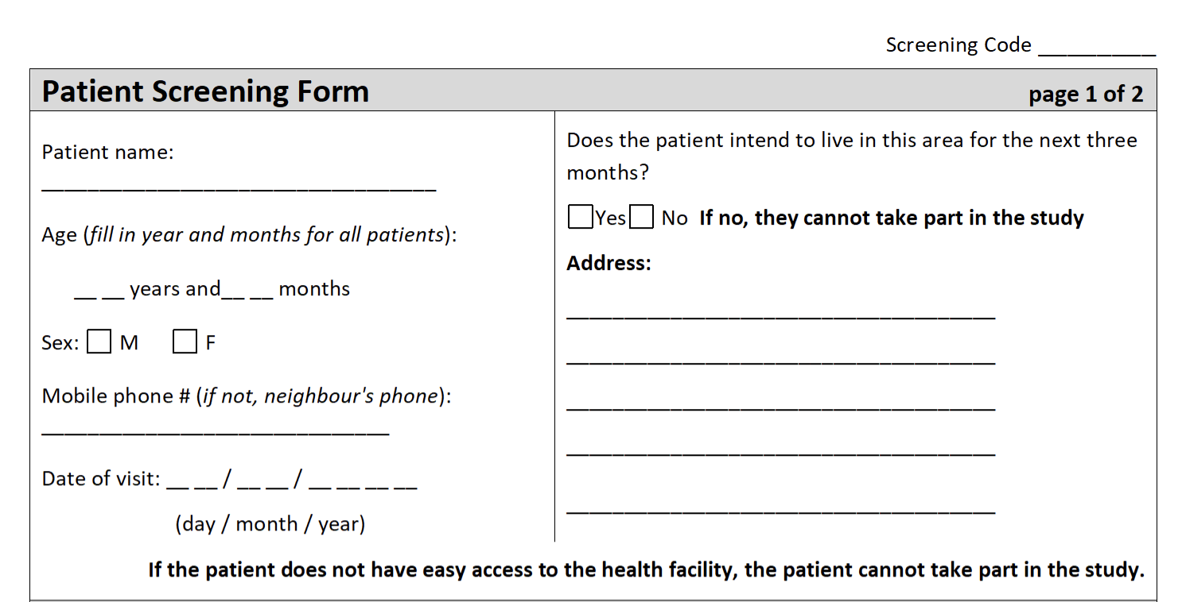
Screening Number Coding
Sequential number starting with 1
1, 2, 3, 4, 5, 6, 7, 8, 9, 10, 11, 12, etc.
1
ATTN!!! Do not put the zero before the number: 001, 002, 003, etc

Slide 74
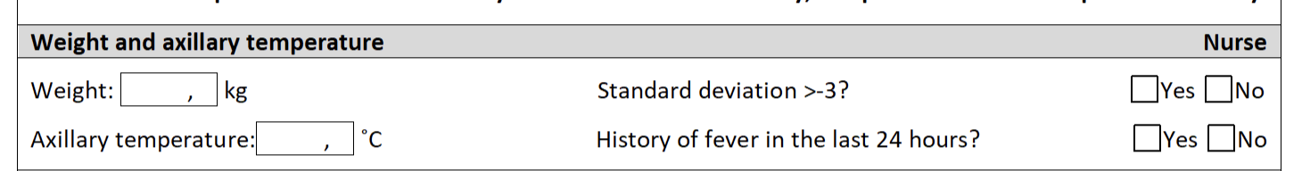
Weight and Temperature section
The nurse looks up the standard deviation corresponding to the child's weight and age in the WHO table
15 2
ATTN!!! Always put a digit after the comma

Slide 75
Weight
Consult the Standard Deviation table
Separate tables for girls and boys

Slide 76
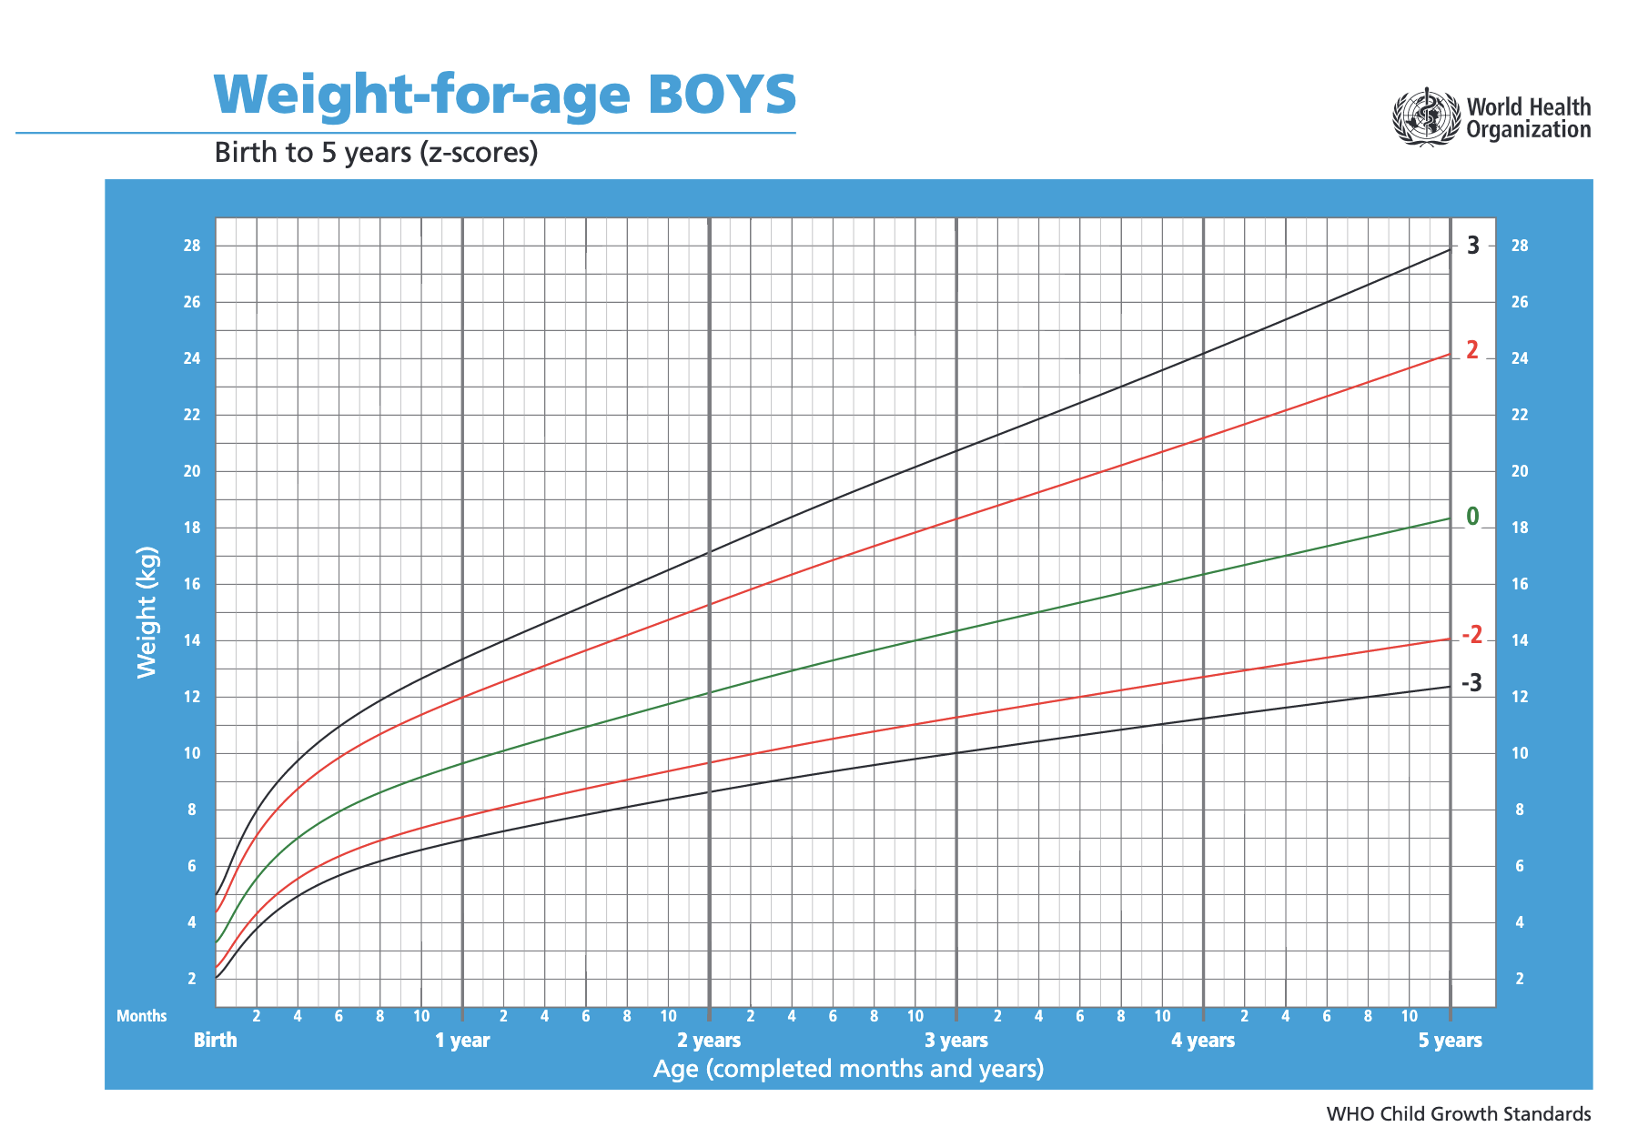
Standard Deviation Table: Boys 0–5 Years
Notes:
Insert your country’s standard deviation table for weight

Slide 77
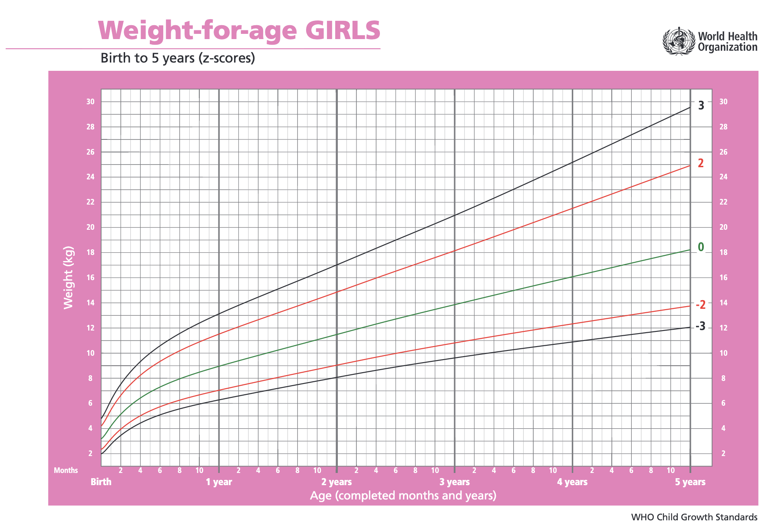
Standard Deviation Table: Girls 0–5 Years
Notes:
Insert your country’s standard deviation table for weight

Slide 78
Weight and Temperature section
The nurse measures the axillary temperature and asks if the child has a history of fever in the last 24 hours
15 2 X
38 1 X

Slide 79
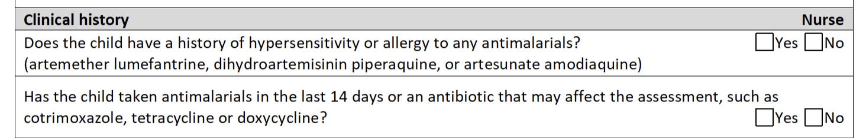
Clinical History Section
The nurse checks if the child has a history of hypersensitivity/allergy to the medicine
X

Slide 80
Signs of hypersensitivity or allergy
When the child has taken this medicine in the past, has he/she had one of the following signs?
Itching
swelling of the face, lips or tongue
Red skin rash or skin rash
Pimples on the skin
Difficulties breathing

Slide 81
Clinical History Section
The nurse asks if the child has taken an antimalarial or an antibiotic that has antimalarial effects
X
X

Slide 82
Medicinal products with antimalarial effect
Cotrimoxazole
Tetracycline
Doxycycline
Quinin
Chloroquine
Sulfadoxine
Others?

Slide 83
Clinical Examination
When the lab results are ready, the mother goes back to the clinic room and the doctor does a clinical examination

Slide 84
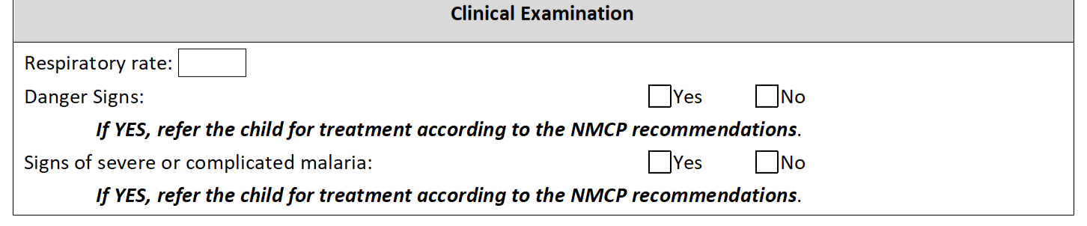
Clinical Examination Section
The doctor calculates the respiratory rate
Respiratory rate determines the absence or presence of pneumonia or bronchopneumonia
22

Slide 85
Clinical Examination Section in the Screening Form
The doctor checks the child for danger signs or signs of severe malaria
22
X
X

Slide 86
Temperature >37.5C: fever
Standard deviation < -3 ___________________
Haemoglobin < 8 ____________________
Parasitemia > 200,000________________

Slide 87
Temperature >37.5C: fever
Standard deviation < -3 Malnutrition
Haemoglobin < 8 Anaemia
Parasitemia > 200,000 Hyperparasitemia

Slide 88
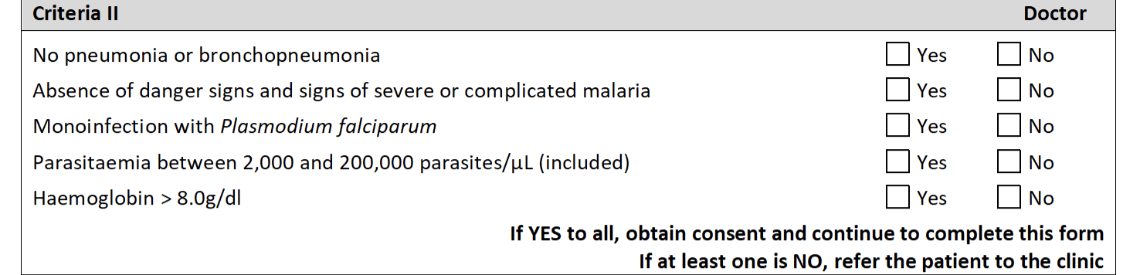
Section II Criteria in the Screening Form
The doctor reviews the laboratory results of the clinical examination and checks whether the child meets the remaining inclusion criteria

Slide 89
Consent
If the child meets all the inclusion criteria, the doctor obtains consent
The doctor reads the informed consent to the carer
The accompanying person signs the consent form
If the carer does not know how to sign, a witness must attend the reading of the consent and sign the consent
The doctor signs the consent form

Slide 90
Registration
If the carer gives consent, the child enters the study
The nurse opens a new folder (already prepared)
The child receives an individual code, which can be found on the labels in the folder

Slide 91
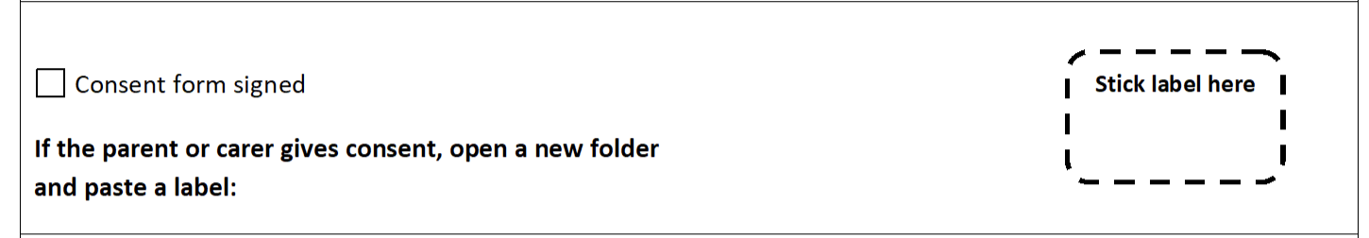
Registration
The nurse sticks a label on the Triage Card
FR19-023
Notes:
UPDATE!!!***

Slide 92
Labels - Patient Code
Letters indicating the province and medicine
BDL – Bo, District Hospital, AL
BDQ – Bo, District Hospital, ASAQ
BJL – Bo, Jembe Community Health Center, AL
BJQ – Bo, Jembe Community Health Center, ASAQ
KDL – Kenema, District Hospital, AL
KDQ – Kenema, District Hospital, ASAQ
MDL – Makeni, District Hospital, AL
MDQ – Makeni, District Hospital, ASAQ
MKL – Makeni, Kalangba Community Health Center, AL
MKQ – Makeni, Kalangba Community Health Center, ASAQ
BDL21-023
Sequence code of the patient
Year of
study
Notes:
Add nomenclature for site name***

Slide 93
Labels - Patient Code
On which material do you place the labels? (select all that apply)
Medical records
Calendar
ID card
Samples on filter paper
Microscopy slides
Outside of the file

Slide 94
Labels
Attention: Stick a label on each filter paper card and each sample

Slide 95
Placing the labels
Outside of the file
Each form (Screening, D0, D1, ....D28 OR D42)
Patient ID card
Calendar (D1 to D42)
Filter papers
Slides

Slide 96
Medical Record - Day 0

Slide 97
Coartem (AL)
Dosing of artemether-lumefantrine (AL): Administer with food
Weight | Dose
5 -14.9 kg | 1 tablet per serving
15 -24.9 kg | 2 tablets per dose
25 -34.9 kg | 3 tablets per dose
≥35 kg | 4 tablets per dose
1 tablet contains 20mg artemether and 120 mg lumefantrine
DAY 0
DAY 1
DAY 2
0h
8h
24h
36h
48h
60h

Slide 98
Dihydroartemisinin-piperaquine (DP)
Dosage of dihydroartemisinin-piperaquine (DP)
Weight | Dose
5-9.9 kg | 0.5 tablet per dose
10-19.9 kg | 1 tablet per serving
20-39.9 kg | 2 tablets per dose
≥ 40 kg | 3 tablets per dose
1 tablet contains 40mg dihydroartemisinin and 320 mg piperaquine
DAY 0
DAY 1
DAY 2
0h
24h
48h

Slide 99
Artesunate-amodiaquine (ASAQ)
Dosage of artesunate amodiaquine (ASAQ)
Weight | Dose
4.5-8.9 kg | 1 tablet 25 mg AS/67.5 mg AQ
9-17.9 kg | 1 tablet 50 mg AS/135 mg AQ
18-35.9 kg | 1 tablet 100 mg AS/270 mg AQ
≥36 kg | 2 tablets of 100 mg AS/270 mg AQ
DAY 0
DAY 1
DAY 2
0h
24h
48h

Slide 100
Dosage of Coartem (AL)
Dosage of artemether-lumefantrine (Coartem)
Weight | Dose
5 -14.9 kg | 1 tablet per serving
15 -24.9 kg | 2 tablets per dose
25 -34.9 kg | 3 tablets per dose
≥35 kg | 4 tablets per dose
1 tablet contains 20mg artemether and 120 mg lumefantrine

Slide 101
Dosage of Coartem (AL)
Give the dose of coartem with food
Biscuits administered with first dose
Give additional biscuits to take with the coartem dose in the evening
Notes:
Insert fatty food

Slide 102
Dosage of ASAQ
ASAQ has tablets with three different formulations
Dosage of artesanate-amodiaquine (ASAQ)
Weight | Dose
4.5-8.9 kg | 1 tablet 25 mg AS/67.5 mg AQ
9-17.9kg | 1 tablet 50 mg AS/135 mg AQ
18-35.9kg | 1 tablet 100 mg AS/270 mg AQ
≥36 kg | 2 tablets of 100 mg AS/270 mg AQ

Slide 103
Dosage of DP
Dosage of Dihydroartemisinin-piperaquine (DP)
Weight | Dose
5-9.9 kg | 0.5 tablet per dose
10-19.9 kg | 1 tablet per serving
20-39.9 kg | 2 tablets per dose
≥ 40 kg | 3 tablet per dose
1 tablet contains 40mg dihydroartemisinin and 320 mg piperaquine

Slide 104
Vomiting
If vomiting occurs within 30 minutes, the nurse repeats the entire dose and notes the time
If vomiting occurs between 30 and 60 minutes after administration, the nurse gives half a dose and notes the time
If the child vomits twice (or more), the child should be taken out of the study and given alternative medication

Slide 105
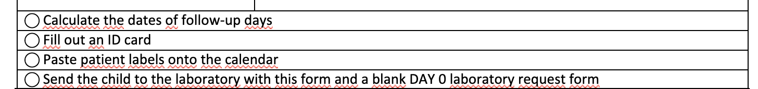
After the first dose of medication, Clinical Form – Follow up Day 0
The nurse calculates the dates of the follow-up days, using the scheduling table
X

Slide 106
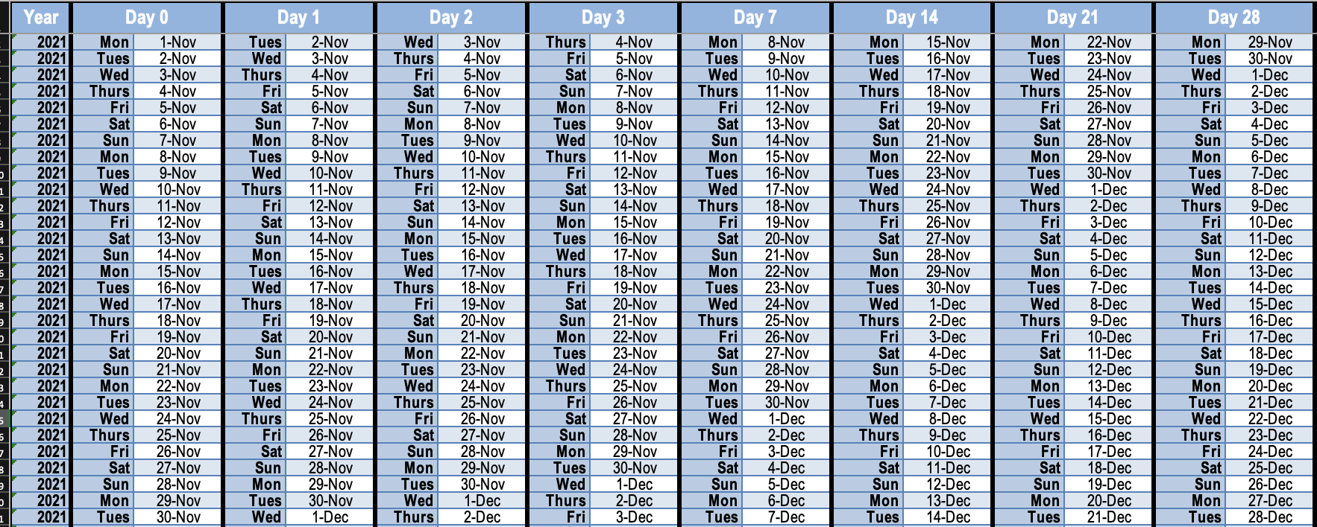
Programming table

Slide 107
Programming table
Find today's date in the Day 0 column
When you find the row where the date is located, use the row to identify follow-up days

Slide 108
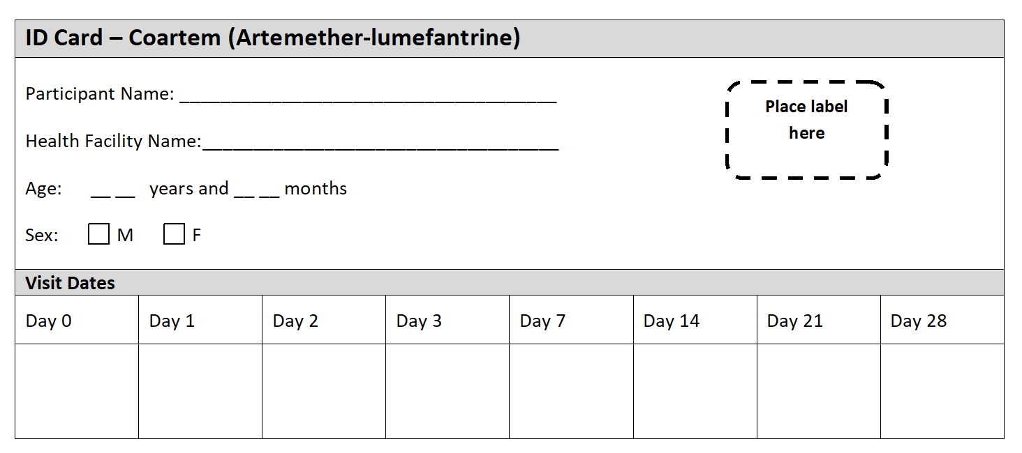
ID card

Slide 109
ID card
The nurse completes the identification card, including the dates of the follow-up visits
The nurse puts a label
So-and-so
ZZ19-201
Municipal Hospital
03 06
X
4 March
(Monday)
5 March
(Tuesday)
6 March
(Wednesday)
7 March
(Thursday)
11 March
(Monday)
18 March
(Monday)
25th March
(Monday)
1 April
(Monday)
Notes:
**cross check with ID card Anitta sent

Slide 110
Second Dose of Coartem
The nurse will give a 2nd (and a reserve) dose for the mother to take with her
The mother should give the 2nd dose in the evening 8 hours after the administration of the medicine
Dosing with food - biscuits
The local activist will call the mother (or neighbour) to remind about the dose
Caregiver will bring the empty packet and unused tablets the next day
Notes:
Change all reference of local activist to community tracer

Slide 111
Vomiting
If there is vomiting:
within 30 minutes
repeat the entire dose and note the time
between 30 and 60 minutes
give half a dose and note the time
2 times or more
the child should leave the study and receive alternative medication
Notes:
**check with protocol

